Slide 1
Kev Crowley
Email Responses

Slide 2
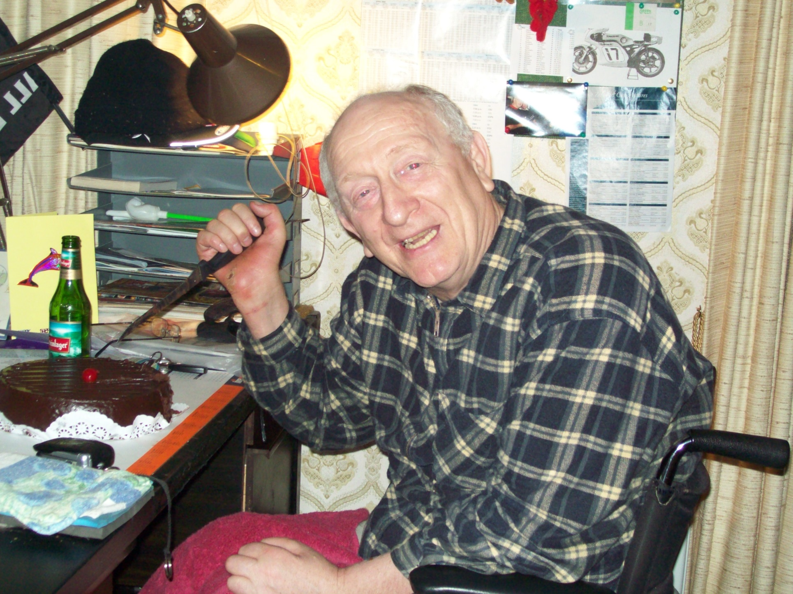

Slide 3
KPJC
CROWLEY, Kevin Patrick.
Peacefully after a short illness at Auckland Hospital on the 20th May 2019; aged 67 years.
Cherished son of Joan and the late Patrick.
Loving brother and brother in-law of Noel and Jocelyn, Earl and Alailevao.
Uncle of Kay, Diane, Robyn, Dean, Cheree, Nyrene, and Earl.
We admired your courage and determination throughout your life. You will be forever in our hearts.
In lieu of flowers, donations to the Salvation Army welcome.
A service to celebrate Kevin, will be held in Fountains Memorial Chapel, 35 Wood Street, Papakura on Friday the 24 May at 1:00pm.

Slide 4
Kev Passed Away
Hi All
Sad to advise that Kev Crowley passed away at 9:18pm today.
I visited Kev this afternoon. Unfortunately he had declined since yesterday and did not open his eyes or speak.
Brother Noel and Jocelyn Crowley were also there.
I will keep you posted when I hear anything further.
Funeral Notice in Wednesday Herald
Service at Fountains Funeral
Elliot Street (By RSA)
1 PM Friday 24th May 2019
Park in RSA (100Meters

Slide 5
Sunday Email
Hi All
Sunday update
Kev Crowley is critically ill in Auckland hospital with pneumonia.
I have just been talking to his brother Earl who has been visiting Kev today.
Kev went into hospital on Thursday afternoon.
Kev is receiving drugs including morphine.
Kev is finding communication difficult. Earl said if you visit he will recognise you but might not be able to chat.
I told Earl I will update those I have on my Exchange Society email list.
Earl has my mobile number.
Murray

Slide 6
Wednesday Email
Funeral
I will have email replies as a PowerPoint as you enter
Funeral Speeches
I said to Earl I would not talk but have been persuaded to tell a couple of Kevs many exploits.
If the Exchange Members can each come up and have one tale to tell it would be good.
Earl and I were at his flat for a couple of hours today.
Earl was looking for one family photo album.
We found six.
The albums need the photos restored by a scrapbooking expert.
After Funeral
Nibbles then
Papakura RSA
Murray

Slide 7
The Exchange Society
The Exchange Society is a group of mates from the 1970s
We drank in the upstairs bar of the Exchange Hotel one night a week for several years.
Kevin Crowley
Joe Curtis
Don Robertson
Andrew Harris (Tweed)
Mike Will
Martin Douglas
Rob Ritchie
Murray Gallagher
Plus many other visitors

Slide 8
Bernie and Andrew Harris
Dear Murray and Helen,
Thank you for letting us know. Very sad indeed. He was a true legend and muchly loved.
It was so good to catch up with you all and of course the wonderful Mr Crowley when we were in NZ.
Our thanks also for being a great friend. Please keep us posted re funeral etc.
Sending love to you both and to the crew who we will write to separately.
Bernie and Andrew
London
Johnny Hart was a 4 Dunedin St flatmate

Slide 9
Andrew Harris
Hi Murray
Obviously we are bit too far away to make it to the funeral but I am glad that you will be saying something. Of all of the old gang you knew Kevin the longest and the best.
I suspect you will have a big turn out. Kevin collected lots of friends along the way and put in a lot of effort - most of which passed un-noticed- maintaining those friendships.
As Chris Curtis remarked, he was just a really friendly bloke and an important part was the quirky humour.
In the early days of us living here, before internet, we didn’t hear much about what was happening in NZ but every month or so an A4 envelope would arrive in the post, out of which would spill clippings from the Herald and other sources. No letter - just clippings. Some covered motorsport but others news of nieces and nephews and just plain quirky stuff that he had noticed and though might give us a laugh. The classic was a birthday card sent to Bernie that was cut from the flap of a Wheatbix packet on which he had written “Happy birthday Mrs H - and don’t forget your fibre you beaut sheila”.
continued

Slide 10
Andrew Harris
Page 2
I had an email earlier from a bloke, Milan Fistonic, who now lives in Paeroa and who got to know Kevin when he (Milan) made courier deliveries to Hirepool. A mutual interest in car racing got them talking but Milan was very much touched by the man behind the sporting interest. Milan advises that he will be at the funeral.
Our 3 kids have all been in touch and ask to be remembered to the Crowleys. When each of them visited NZ after leaving school, it was Kevin who took them to see Dunedin Street and all the old haunts and sent regular texts checking that they were ok.
We are making a donation to the Salvation Army
Please pass on our best wishes to the family and the old gang.
All the best
Tweed
London

Slide 11
Hannah (Nee Harris)
Hi Murray,
I hope you don't mind me contacting you. I am Andrew and Bernadette's daughter and wanted to get in touch to elaborate on Dad's words about Kevin Crowley. I am sure you will have many messages/condolences/stories to talk about at the funeral but he was such a kind and brilliant man I just wanted to say something.
I was only just about to turn 8 when we left NZ but I remember Kevin well - we only ever called him 'Mr Crowley' - I'm not sure why! But he used to come to have fish and chips with us every Friday night. I remember he would turn up and we would go out to help get his chair out of the car so he could come up the ramp to get into the house. He was a warm and fun man and felt like part of the family.
Continued
Hannah

Slide 12
My brothers and I have all taken 'gap' years in between school and university and each of us in turn went back to NZ to travel and/or work for a few months. My youngest brother and I both returned after finished university for some time and Kevin would get in touch each time we were visiting and ensure that we caught up. During my first trip back to NZ as an 18 year old reconnecting with my home country, Kevin picked me up one morning in his car and proceeded to take me on the most amazing road trip around the city. He drove around such a huge distance, taking me to show the flat where you all used to live together, the rugby club where he spent time as a young man, the church where my parents got married, driving me past the hospital where I was born and my old school and to look at the house where we used to live in Greenlane. All before taking me out for a delicious lunch. He was a gentle and kind man with a cheeky sense of humour. I also remember the packages my Dad mentioned in his email - they never ceased to bring a smile to my parents' faces and were so appreciated in a time when I'm sure my parents would have felt very homesick, living so far away from friends and family in a time before the luxury of the internet.
I know he will be hugely missed by so many people and hope that you all have the chance to celebrate and remember him fondly tomorrow. Wishing lots of love to his friends and family.
All the best,
Hannah
Bernadette and Andrew Harris Daughter London

Slide 13
Angie Hart
thank you Murray :(. A sad day for all who love him. A day for leaving his body behind. Fly little bird. Xox
Johnny Hart was a 4 Dunedin St flatmate

Slide 14
Don Macleod
Hi Murray Very sorry to hear of Kevin's passing. As you were one of his close mates I pass on my deepest sympathy. Thank you for keeping us up todate. best regards Don

Slide 15
Brian & Lisa Gaston
Hi Murray,
Lisa here, thank you for your message and more hugely your friendship with Kevin. Shattering news, so glad I was speaking with Kevin just last week, Sophie and I have always and will always have a great place for him in our hearts.
Too sad . . . .
Lisa xo
Lisa Kevin’s Nurse
Brian Computer engineer with Don & Murray

Slide 16
Sue Tonner
Hi Murray
Thank you so much for keeping in touch regarding Kevin.
So, so sad I am pleased I got to see him when the Tweeds came over.
I know everyone will agree what a lovely man Kevin was, always smiling. He never changed from the time I met him 40 odd years ago, and how he loved to dance. He touched so many people and will be sadly missed.
Sue xxx
Monica Will Sister

Slide 17
Don & Liz Robertson
Yes very sad. I guess it comes to us all at some point. Great times have been experienced with Kevin over the years. Many good memories. A nicer person would be hard to find. He will be missed.
Regards Don
4 Dunedin Street Flatmate
Computer Engineer with Murray & Brian
Hi all u fortunately I won't be able to attend Kevin's funeral service. Liz and I would've to be there but we are committed to the wedding of our nice in Dunedin Friday and Saturday.
Please pass on our condolences to the family.
Best regards
Don & Liz

Slide 18
Warren & Flower von Batenburg
Murray
Very sad to hear the bad news. He was a good friend through these years and the linch pin of these old friends. He will be missed.
Cheers
Warren and Flower
Murray
It is with great regret that Flower and I will not be able to attend the funeral today as we are in WA . Please convey our deepest sympathy to family and friends.
Also remember the great cross harbour raft race that was launched from Dunedin st based on Sunderland Flying boat floats and a V8 engine. Great fun at the time. It was one of the events that brought us all together.
Celebrate the life, the humour and perseverance that was Kevin. Sadly missed.
Cheers
Warren & Flower.
Perth Australia
Warren Auckland University 1970

Slide 19
Wendy Bates
Hi Murray and Helen
I am very saddened to hear about Kevin. He was a huge part of our lives when the kids were small and also part of Angie's and Robbie's weddings and Angie's life while she was still in Auckland.
Although we have only caught up with him once in the last 8 years he was, as always, cheerful and a pleasure to talk with. He is one of the nicest men I have ever met and will be really missed.
I'm hoping to make it to his funeral so please let me know when you have more information. The Exchange Society will be bereft.
Wendy
Wendy at Patumahoe School with Murray
Wendy married Rob Ritchie

Slide 20
Angela Comer
Hi Murray
Angela Comer (Ritchie) here. I am so sad to hear of Kevin’s passing. He was a big part of our childhood and someone who I was very fond of. It would be hard to find a better man. I hope to make it to the funeral both for myself and on Dads behalf.
Regards
X
Wendy bates & Rob Ritchie Daughter

Slide 21
Mike Read
Hi Murray
Sad to hear.
Kevin was such a strong character.
Can you put me on your email messages for Kevin
I’m settling in up in Warkworth with a shed full of stuff n projects and building another for a Gurl Cave for Jules for her glass and painting
Happily making home brew
If you are ever up this way drop in for a drop
Mike was a Computer Engineer with Don, Brian and Murray

Slide 22
Christine Curtis
Murray
Thank you Murray for letting us know. A very sad time. As Warren has said Kevin was the lynch pin of everyone. He was one of the nicest people you could ever meet, and he had a fantastic quirky sense of humour. I believe his strength of character touched everyone and his memory will live on in us all.
My thoughts are with you Murray and his family at this sad time.
Christine xx
Husband Joe at University 1970
Flatted with Murray at Avondale

Slide 23
Trude Bethell John Paice
Dearest All,
This is Trude writing this to you all from myself and John Paice.
Tears in our eyes with love of this wonderful wonderful caring and heart soul of our dear
friend.
Kevin was always on our minds and his visits here were fun and exciting with his news
and antics.
Kevin's journey has not been easy but Kevin showed all he met in his life how to beat
adversity - yeah!!! what a celebration and he will forever be in our hearts.
We have a busy day on Friday especially mid day - Eeek!!! I will ensure John is with you
and that I will be here with tears of love for Kevin and you all.
Love, huge huge hugs and I will look forward to John coming home with stories told at
Kevin's passing into his next life ceremony.
Love
Happiness and success always Trude Bethell

Slide 24
Hi Murray:
Thank you so much for the updating.
I will be there this Friday.
I have some nice photos of him, if you need them just let me know.
See you then
Ping
Regards
Kevin’s Nurse

Slide 25
Trish Marsters
Thank you for letting me know the sad news of Kevin's passing. He will be remembered very fondly by all of us.
Rest in love and peace, Kevin.
Trish Marsters,
Mangaia, Cook Islands
Jo Marsters played rugby with Kevin

Slide 26
Judy Paton
Hi Murray
So Sad.
You’ll miss him
Sure he will get a great send off.
Jude
Napier
Flatmate Christine Curtis
Auckland university 1971

Slide 27
Roger Hardstaff
Thanks Murray
Kevin will be with Edward Mckinney from Puke East, in our classes.
Rog
Roger with Kevin Pukekohe High School 1965-1968
Merlinit.co.nz Director with Murray Gallagher

Slide 28
Ross & Chris Mason
Sorry to hear about Keven
Ross
Wellington
Ross with Kevin Pukekohe High School 1965-1969

Slide 29
Jim Johnson
Was told by Jan Johnson of Kevin’s passing.
Will attend on Friday
Friends Sue Tonner Angie Hart
4 Dunedin street

Slide 30
Greg Howe
Good to have seen Kevin at Patty Rugby.
Pukekohe High School 1965 1968

Slide 31
Richard Walker
Hi Murray,
Thanks for keeping me in he loop on Kev. Unfortunately I have been in bed all week with some nasty lurgi
- I was really hoping to be well enough by today to be able to get to Papakura but regretfully not.
Would you please pass on my condolences to Kevin's family and apologise to them that health has kept we away today.
Please also remember me to those familiar names who appear on your exchange list.
I have been very poor at keeping in contact with old friends in recent years, something which I intend to put right in the coming months.
Richard.
Richard was at ICL Computers with Brian, Don , Mike and Murray.

Slide 32
Paul Young Rob Ritchie
Rob Ritchie rang Paul on Friday
Murray rang Paul on Sunday.
Paul Married to Rob Ritchie Sister
Rob ex Wendy Bates attended funeral.

Slide 33
Jim Height
Murray Emailed Sunday
4 Dunedin Street
Pukekohe High School 1965 1969

Slide 34
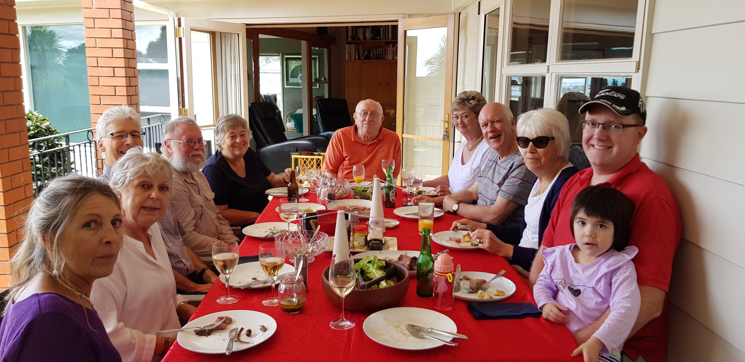
Final Photo Wills residence 24 March 2019
Sue Tonner, Monica Will, Don Robertson ,Murray & Helen Gallagher, Kevin Crowley ,Bernadette & Andrew(Tweed) Harris, Liz Robertson , Andrew Will & Daughter

